Slide 1



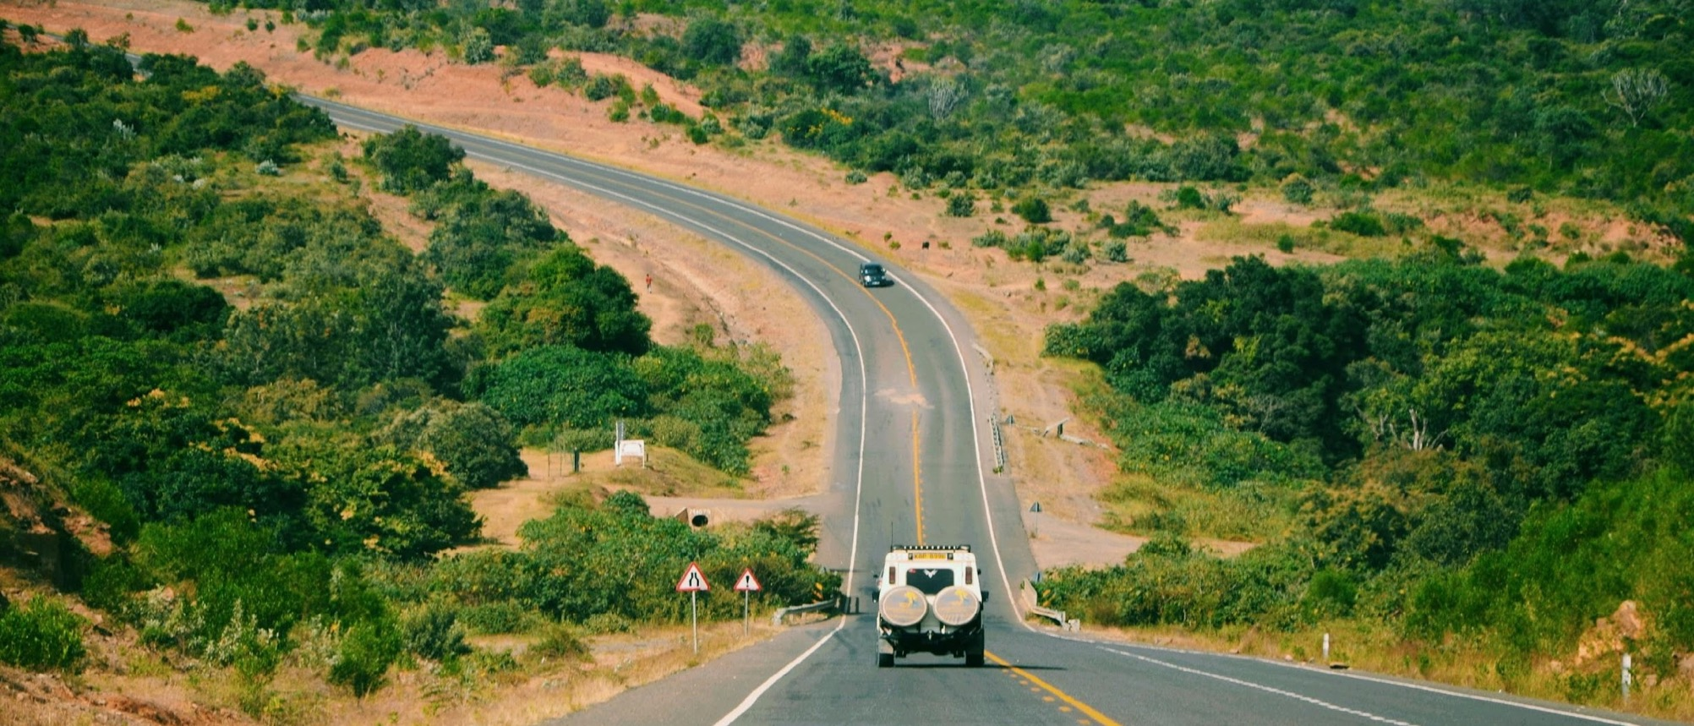
BASELINE SURVEY OF AFRICAN ROAD FUNDS
Road Maintenance Funding and Resilience – Next Generation Funds
ARMFA-AFERA Stakeholder Meeting
Nairobi, Kenya 16-18 September 2025
EC-INTPA/2024/EARP/0021

Slide 2
PART 1: SITUATIONAL ANALYSIS
Presented by Maurice Niaty-Mouamba
Institutional/Governance Expert, TA Team

Slide 3
Summary of the current situation
FACTORS | FIRST GENERATION | SECOND GENERATION | THIRD OR NEXT GENERATION
Governance | Managed within ministries Weak autonomy | Expectations To improve governance structures and ensure greater accountability Strengthen autonomy by reducing direct control from central administrations and treasuries Managed within Board/management committee + management organs and/or a control organ Present situation Unbalanced board composition Decisions often driven by political considerations Many Road Funds operate under control of ministries or national treasuries, reducing their independence. Difficulties to assess performance due to limited monitoring and evaluation system | Autonomy with robust legal framework, transparent and accountable governance

Slide 4
Summary of the current situation
FACTORS | FIRST GENERATION | SECOND GENERATION | THIRD OR NEXT GENERATION
Financing source | Government budgets Inconsistent allocations Do no cover the minimal maintenance Poorly managed and diverted to other purposes Public budgets deficits no longer reliable to finance maintenance. | Expectations Establish sound financial systems with transparent management of funds Enhance operational performance through better planning, management and monitoring Achieve financial sustainability by securing and managing the revenue sources (fuel levy, tolls, vehicle registration fees…) Integrate emerging priorities, including climate change resilience and social inclusion. Present situation Despite efforts from of Road Funds few of them met these objectives Still vulnerable to fuel tax variation and diversion | Diversified revenue mix: user charges + innovative sources (PPPs, climate finance, donor co-financing) Ring-fenced against diversion

Slide 5
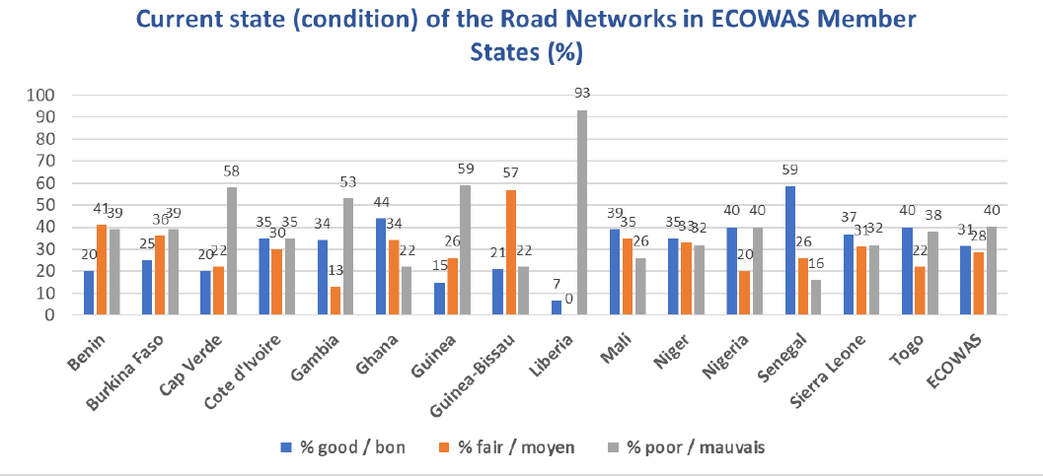
Summary of the current situation
Région | Superficie | Population | Réseau routier | Réseau revêtu | Réseau non revêtu | Densité routière
 | (km²) | (10⁶ hab.) | (km) | (km) | (km) | (km/100km²)
Centre | 3 021 180 | 29,654 | 115 677 | 18 531 | 97 146 | 3,83
Est | 6 755 902 | 233,87 | 445 018 | 103 600 | 341 418 | 6,59
Nord | 9 301 385 | 165,07 | 292 790 | 161 825 | 130 965 | 3,15
Sud | 6 005 240 | 108,77 | 801 751 | 235 154 | 566 597 | 13,35
Ouest | 5 112 060 | 223,24 | 409 377 | 91 660 | 317 717 | 8,01
Total | 30 195 767 | 760,60 | 2 064 613 | 610 770 | 1 453 843 | 6,84
Source : Ecowas RF study
Source : CEA

Slide 6
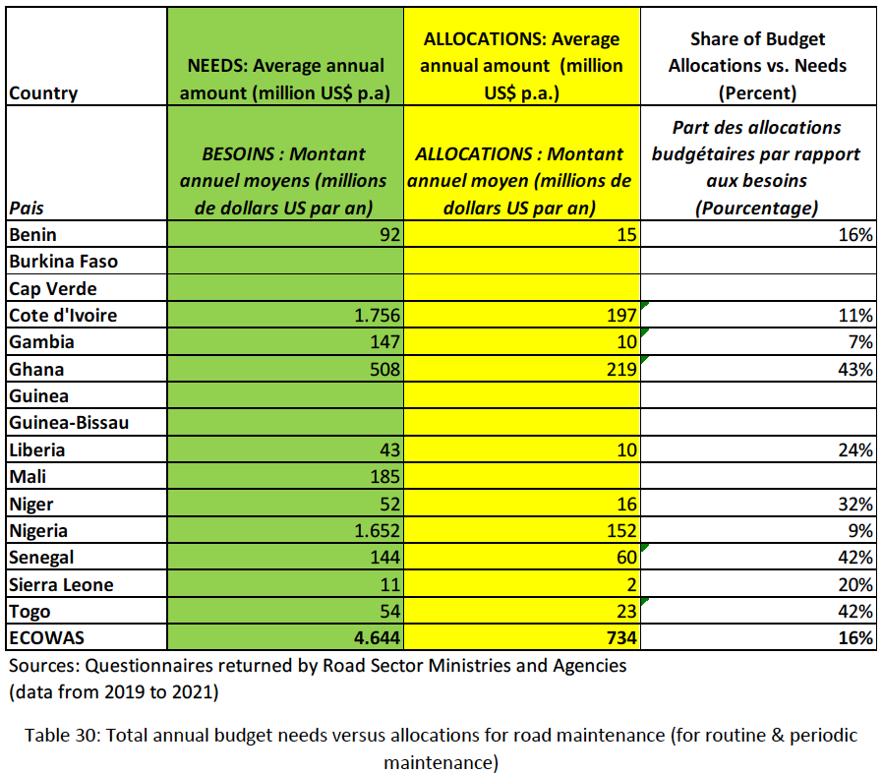
Summary of the current situation

Slide 7
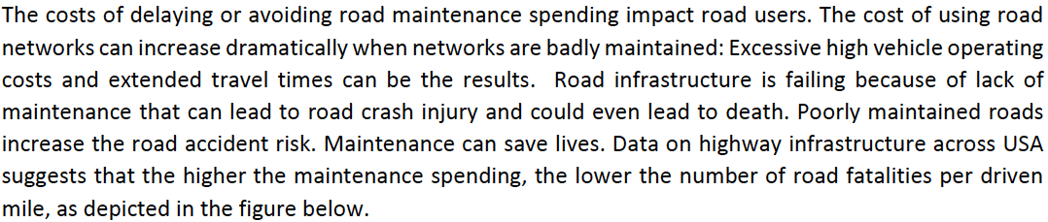
Summary of the current situation

Slide 8
PART 2: INCEPTION PHASE
Presented by Dr. Sid Boubekeur
Public Financing Expert and Coordinator, TA Team

Slide 9
Critical Questions for Road Fund Stakeholders and Managers
How to enhance road maintenance:
to improve connectivity between urban and rural areas
increase people’s mobility, and facilitate the transport of goods
reduce the cost and time for their commercialization?
2. How can we leverage new financing models, including blended finance (user taxes, climate finance, PPPs) combined with technical assistance to Road Fund Boards to succeed the transition?
3. How can new policy reforms support the transition of Road Funds to the next generation:
With a robust legal framework
Free from political interference
Financially sustainable
Integrating climate resilience into planning and budgeting,
Promoting gender equality and youth participation
4. How to position the Road Funds at the forefront of emerging opportunities supported by donors and development finance institutions, focusing on the development of transport corridors in Africa, including road construction, rehabilitation and the essential maintenance needed to ensure their long-term sustainability.

Slide 10
1. Background and Objective of the Assignment
Two decades after the establishment of Second Generation of Road Funds, several critical issues continue to affect their efficiency and long-term sustainability:
Governance gaps persist, including imbalances in board members composition.
The available budgets are insufficient to match the growing volume of roads requiring maintenance resulting in cumulative backlogs.
Road Funds depend primarily on user charges, such as fuel levies and tolls, which are insufficient to effectively respond to the numerous road damages caused by climate change
These issues place Road Funds under continuous stress, making it difficult to plan, prioritize, and implement maintenance activities efficiently and responding to the needs of road users.

Slide 11
2. Design of a Policy Document for Transitioning Roads Funds to the Next Generation
The project has three overarching purposes:
Diagnostic of the current status of 15 Road Funds focusing on governance practices, funding and operations mechanisms, resilience to climate change readiness, and inclusion of gender equity and equality.
Definition of principles and practices of “third-generation” Road that:
implement governance and transparency mechanisms
blend diverse revenue sources for meeting the expected targets on road maintenance
integrate resilience and climate finance are more inclusive.
Develop a policy document, including the key findings, the Next-Generation Road Fund model, the recommendations and an action plan to be submitted to the next Ministerial Transport and Finance meeting which will take in 2026

Slide 12
3. Stakeholders’ Engagement to ensure Project Success and Foster Ownership
A participatory and consultative approach will be implemented to ensure that ARMFA and the selected Road Funds focal points are fully engaged throughout the survey process. To this end, the Experts will:
Establish continuous and effective communication with ARMFA, focal points, and relevant national stakeholders to facilitate collaboration on the project and to ensure timely responses to the requested questions.
If necessary, they will adapt tools and processes based on the quality of data received and response rates.
Provide regular reporting to SSATP-EU and ARMFA on the progress and challenges of the project.
Sharing information with SSATP-EU and ARMFA on the challenges faced by Road Funds but also the best practices applied by the Road Funds and lessons learned.
This approach will:
Enhance information and data quality and sharing for analysis
Build ownership
Ensure that the final recommendations and policy document are aligned with their expectations for transitioning to third-generation Road Funds.

Slide 13
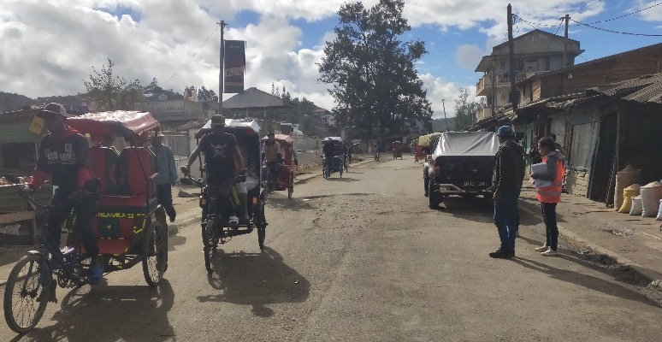
4
Key Implementation Phases

Slide 14
Phase 1. Inception
REVIEW OF EXISTING DOCUMENT
. Legal status of the Road Fund Second generation
. Road Fund annual technical and financial reports
. ARMFA annual reports
. World Bank-SSATP studies
. Reports on the impact of climate change on roads assets
. EU and DFIs studies on transport corridors and regional integration
. Other documents recommended by SSATP-ARMFA
STAKEHOLDER MAPPING
Identification of key institutions for interview:
. ARMFA selected Road Funds
. Non ARMFA members
. Ministries of Finance, Transport/ Public Work
. Donors, Partners, Development Finance Institutions
SURVEY DESIGN AND INTERVIEW GUIDES
AREAS:
. Governance
. Operation
. Finance
. Climate change
. Social inclusion (gender equity-equality)
. Regional integration/transport corridors initiatives
. Policy reform recommendations from Road Funds
INCEPTION REPORT
. Methodology
. Tools for collection of data and analysis
. Engagement approach
. Data risk management
. Confidentiality aspects
. Workplan

Slide 15

Tools for Diagnostic and Analysis
Diagnostic exercise combining primary and secondary data sources.
Primary data will be collected through the survey questionnaires and interviews with Road Fund focal points
The secondary data will be mobilised through the Road Fund annual technical, financial and audit reports, ARMFA annual reports and conference records, World Bank-SSATP and AfDB, reports, TA TRAC database including reports on transport and road maintenance.
To process and analyse the collected data, the experts will use a range of analytical tools, including dashboards (Excel or Power BI), comparative matrices, reliability scoring grids.

Slide 16
Phase 2. Survey Launch and Data Mobilization
STAKEHOLDER ENGAGEMENT
With the support of ARMFA
. Engage country focal points for collaboration leveraging the Nairobi September 2025
. Present the objectives, scope and expected outcomes
. Secure commitment from focal points to support and participate in the survey process.
. Define roles, responsibilities, and expectations from the Focal Points
SURVEY LAUNCH AND DATA MOBILIZATION
. Distribute the questionnaire to participating Road Funds focal point
. Schedule interviews and working sessions with Focal points and concerned Ministries
. Gather relevant information to refine and adjust the methodology.
INTERIM SUMMARY OF SURVEY RESPONSE
. Highlight initial data quality findings
. Identify data gaps
. Define follow-up actions address data gaps

Slide 17
Phase 3. Data Collection and Validation
INFORMATION AND DATA COLLECTION
. Conduct interviews
. Collect questionnaires replies
. Assessment of secondary sources other institutions
. Triangulation to reconstruct missing elements.
GAP IDENTIFICATION AND CONFIDENCE SCORING
. Identify mission or conflicting information and assign a confidence rating to each data point.
. For low-confidence data, conduct interviews or elaborate written queries to Focal Points to minimize gaps.
DATASET AND RELIABILITY MATRIX
. Compile collected data into a dataset
. Elaborate a reliability matrix informing on the level confidence and any outstanding information requests.

Slide 18
Phase 4. Analysis & Synthesis
COMPARATIVE ANALYSIS
. Benchmark Road Funds across key factors: governance structures, funding sources, revenue mechanisms, disbursement models, transparency practices, institutional frameworks, resilience-readiness, equity.
. Typology of Road Funds (e.g., mature vs. emerging funds, single vs. multi-stream revenue).
NEXT-GENERATION BLUEPRINT
. Draft a set of principles and financing options (dedicated resilience lines, blended mechanisms, performance indicators)
. Identify the best practices for dissemination
DRAFT REPORT
Key findings
Analytical report as a key input in SSATP-ARMFA meetings.

Slide 19
Phase 5. Reporting and Dissemination
FINAL REPORT
. Survey data
. Typologies
. Road Funds profiles
. Benchmarking
. Findings
POLICY RECOMMENDATIONS
NEXT GENERATION OF ROAD FUNDS
. Efficient and transparent governance,
. Financial sustainability,
. Cimate resilience,
. Integration of gender equality and social inclusion
DISSEMINATION
. Debriefing sessions with ARMFA and its Road Fund focal points
. Presentation of findings and policy document in the framework of SSATP-EU conferences on Road maintenance

Slide 20
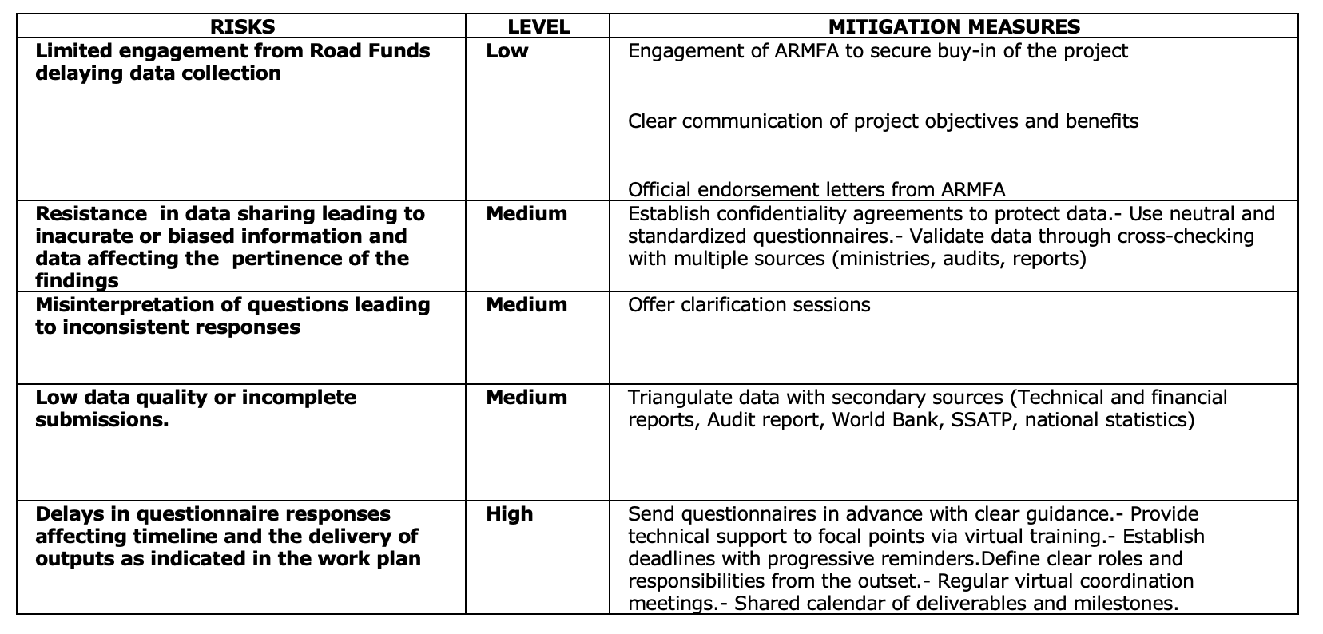
Risks and Mitigation Measures

Slide 21
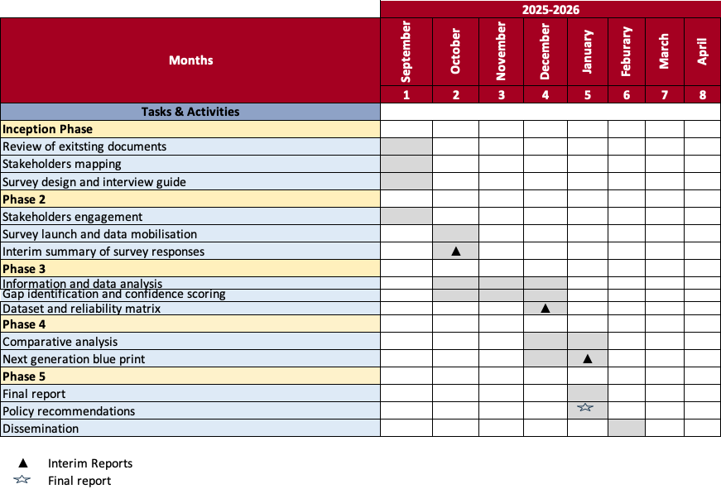
Workplan

Slide 22
PART 3: PRE-SCREENING RESULTS
Presented by Annstellah Wanjiru Maina
Data & Survey Analyst Expert, TA Team

Slide 23
Objectives & Selection Criteria
Main Objectives:
Create profile of AFERA countries
Select 15 countries for the baseline survey
Tentative Selection Criteria & Rationale:
Geographical representation (East Africa, West Africa, Central Africa & Southern Africa)
Evolution of Generations of Road Funds (1st, 2nd & 3rd Generation)
Scale of road networks (Total road network length in km)
High Performance and Low performance (Finance and Resilience and RAMS)
Willingness and readiness to participate to in the baseline survey

Slide 24
Variables of Data Analysis
Overall responsiveness to questionnaire
ARMFA-AFERA regional representation
Years of Road Fund Boards (RFB) operation
Generations of Road Fund (1st, 2nd & 3rd-Generation)
Analysis of the correlation between years of road fund operation and generations of road funds
Analysis Of Classified Trunk Road Networks
Estimated % of annual maintenance needs funded in the last fiscal year
Operations Road Asset Management System (RAMS)
Analysis of the correlation between the road fund generation and utilization of a Road Asset Management System (RAMS)
Dedicated climate-resilience line in annual budget/Policy on Climate Resilience

Slide 25
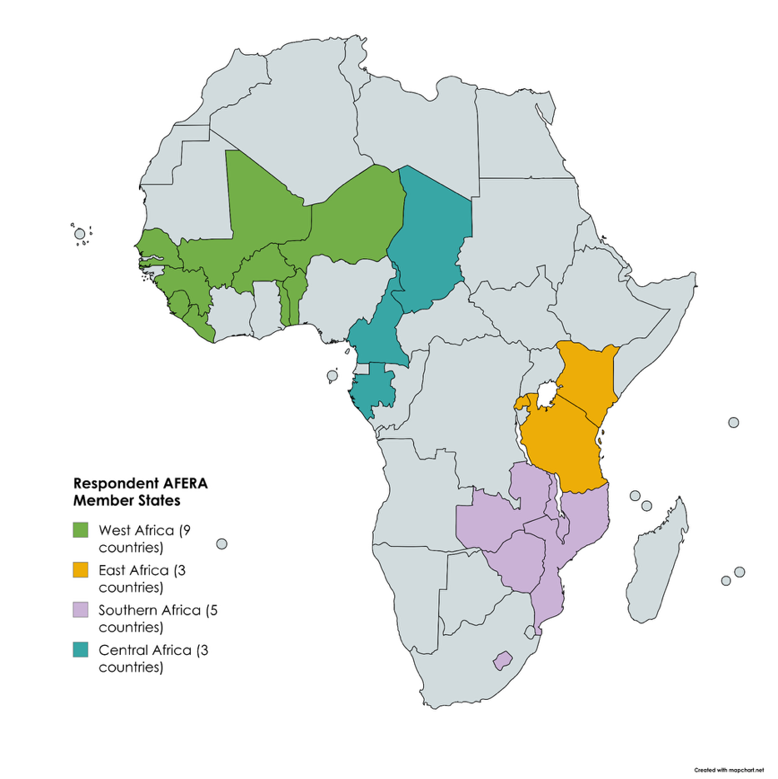
Responsiveness to Screening Questionnaire
Out of 35 ARMFA/AFERA member states that received the pre-screening survey questionnaire, 20 countries responded; representing 57% of responses.
List of respondent countries: Rwanda, Togo, Sierra Leone, Lesotho, Cameroun, Kenya, Zambia, Chad, Zimbabwe, Senegal, Guinea, Malawi, Gabon, Niger, Mozambique, Tanzania, Liberia, Benin, Mali, Burkina Faso
West Africa represented 45% of the total respondents with 9 out of 12 countries.
Southern Africa represented with 5 countries out of 9 member states, accounting for 25% of the responses.
Both Central Africa and East Africa each contributed 3 countries, with 6 and 8 member states respectively, which represents 15% of the total responses from each region.

Slide 26
Years of Road Fund Boards (RFB) operation
Country | Years of Road Fund Board (RFB) Operation
Gabon | 4
Liberia | 7
Niger | 8
Togo | 12
Sierra Leone | 15
Burkina Faso | 17
Senegal | 18
Malawi | 18
Mozambique | 22
Cameroon | 23
Mali | 23
Zambia | 23
Zimbabwe | 23
Tanzania | 25
Chad | 25
Guinea | 25
Kenya | 26
Rwanda | 27
Lesotho | 30
The road fund boards' operational years spanning from 4 to 30 years.
The average operational period is 15 years, indicating that while some funds are well-established, many are still in their formative stages.
The oldest fund is Lesotho's Road Fund Secretariat with 30 years of operation.
The newest is Gabon’s Fonds Autonome National d'Entretien et d'Investissement Routier (FANEIR) with only 4 years of operation.
The distribution of evolution is as follows:
11 countries (55%) have funds that are over 21 years old, suggesting a high level of institutional entrenchment.
5 countries (25%) fall into the 11-20 year range, representing a mid-tier of evolution.
4 countries (20%) have funds that are 10 years old or younger, indicating they are in a nascent phase of development.

Slide 27
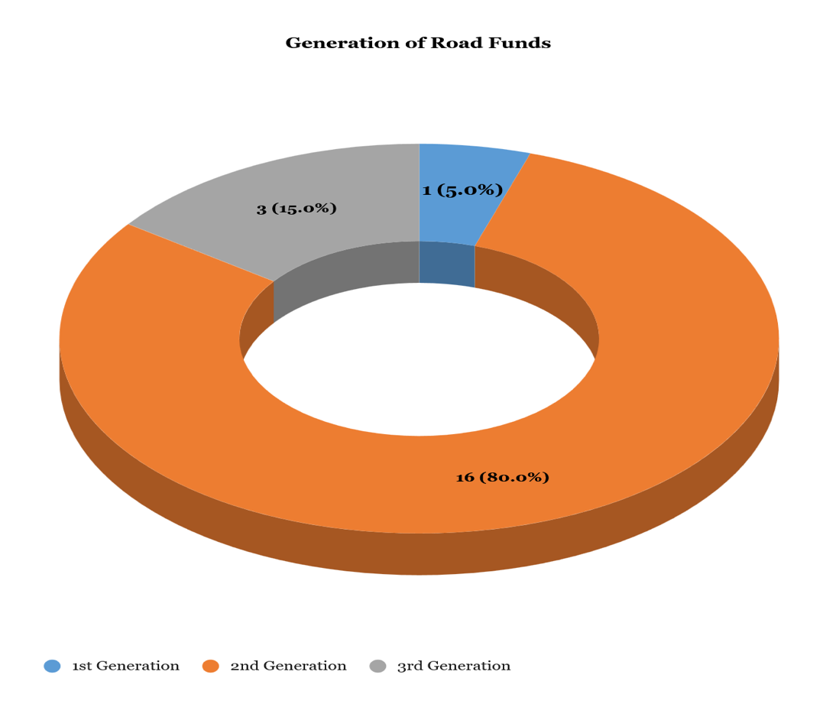
Generations of Road Fund (1st, 2nd & 3rd-Generation)
1st-Generation: 1 country (5% - Liberia) operates with a first-generation road fund, which is typically treasury-dependent.
2nd-Generation: The majority, 16 countries (80%), have second-generation road funds, characterized by an autonomous model with dedicated revenue from user charges.
3rd-Generation: 3 countries (15%) have advanced to the third-generation model, which includes diversified revenue streams and a focus on performance management.

Slide 28
Years of Road Fund Operation Vs Generations of Road Funds
Country | Years of RFB operation | Generation of Road Fund
Lesotho | 30 | 2nd generation
Rwanda | 27 | 2nd generation
Kenya | 26 | 3rd generation
Tanzania | 25 | 2nd generation
Guinea | 25 | 2nd generation
Chad | 25 | 2nd generation
Mali | 23 | 2nd generation
Zimbabwe | 23 | 2nd generation
Cameroun | 23 | 3rd generation
Zambia | 23 | 2nd generation
Mozambique | 22 | 2nd generation
Malawi | 18 | 2nd generation
Senegal | 18 | 2nd generation
Burkina Faso | 17 | 2nd generation
Sierra Leone | 15 | 2nd generation
Togo | 12 | 2nd generation
Niger | 8 | 2nd generation
Liberia | 7 | 1st generation
Benin | 4 | 2nd generation
Gabon | 4 | 3rd generation
A longer operational history does not necessarily correlate with a more advanced generation model.
For example, while the oldest funds are mature second-generation funds, the third-generation category includes countries with both new and long-standing funds, such as Gabon (4 years) and Kenya (26 years).
This suggests that the transition to a higher-generation model is driven less by institutional age and more by a proactive commitment to sector reform.

Slide 29
Analysis Of Classified Trunk Road Networks
Country | Total road network length (km) | Paved network length (km) | % of total | Unpaved network length (km) | % of total
Kenya | 239,122 | 25,411 | 10.627 | 213,711 | 89.373
Tanzania | 188,000 | 15,000 | 7.979 | 133,000 | 70.745
Cameroon | 121,800 | 10,000 | 8.210 | 111,800 | 91.790
Zimbabwe | 90,000 | 18,000 | 20.0 | 72,000 | 80.0
Mali | 89,024 | 6,511 | 7.3 | 82,513 | 92.7
Guinea | 43,500 | 6,600 | 15.2 | 36,900 | 84.8
Zambia | 40,454 | 26,121 | 64.6 | 20,827 | 51.5
Mozambique | 30,000 | 8,500 | 28.3 | 21,500 | 71.7
Malawi | 24,929 | 4,798 | 19.2 | 20,131 | 80.8
Niger | 22,795 | 5,808 | 25.5 | 16,987 | 74.5
Senegal | 16,481 | 6,569 | 39.9 | 9,912 | 60.1
Burkina Faso | 15,272 | 4,076 | 26.7 | 11,196 | 73.3
Togo | 15,000 | 2,510 | 16.7 | 12,490 | 83.3
Sierra Leone | 11,300 | 3,544 | 31.4 | 7,756 | 68.6
Liberia | 10,600 | 657 | 6.2 | 9,943 | 93.8
Gabon | 10,344 | 2,039 | 19.7 | 8,133 | 78.6
Rwanda | 6,889 | 2,066 | 30.0 | 4,823 | 70.0
Lesotho | 6,792 | 1,877 | 27.6 | 4,974 | 73.2
Chad | 6,204 | 2,300 | 37.1 | 2,300 | 37.1
Benin | 5,945 | 3,965 | 66.7 | 1,980 | 33.3
Overwhelming predominance of unpaved roads across most of the surveyed countries. With unpaved networks constituting 70% or more of the total road length in countries like Kenya, Cameroon, Guinea, Mali, Liberia.
Maintenance strategies must be tailored to address the high vulnerability of these networks to weather events and climate-related risks.
The current funding gaps are likely exacerbated by the high maintenance demands of these unpaved networks, which require different and often more frequent interventions than their paved counterparts.

Slide 30
Estimated % of Annual Maintenance Needs Funded
Country | In the last fiscal year, what proportion (%) of total annual maintenance needs were actually funded?
Rwanda | 80
Guinea | 66
Chad | 66
Benin | 60
Kenya | 50
Mozambique | 45
Tanzania | 45
Gabon | 42
Senegal | 41
Togo | 40
Lesotho | 30
Zimbabwe | 30
Burkina Faso | 25
Sierra Leone | 16.56
Mali | 16
Liberia | 13
Cameroon | 8
Malawi | 5
Niger | N/A
Zambia | N/A
On average, only 37.7% of the total annual maintenance needs were funded in the last fiscal year.
Countries with the highest funding proportions are Rwanda (80%), Guinea (66%), and Chad (66%).
Countries with the lowest funding proportions are Malawi (5%) and Cameroon (8%).
For over a year Malawi’s Road Fund Administration has not been receiving fuel levy (which is about 85% of the Roads Fund revenues)
Mozambique’s fuel taxes have not been updated since 2009, causing them to lose their purchasing power over time.

Slide 31
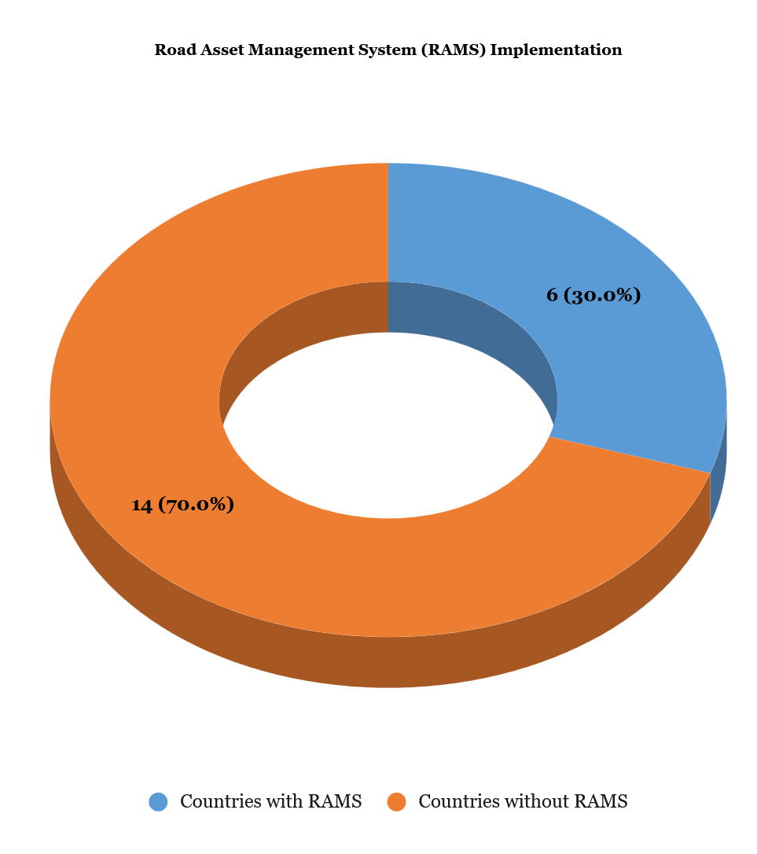
Operations Road Asset Management System (RAMS)
A significant majority of the respondent countries are operating without a Road Asset Management System (RAMS).
Only 6 (30%) of the 20 surveyed countries have an operational RAMS, while 14 (70%) do not.
This highlights a critical gap in digital readiness and a significant barrier to data-driven decision-making for road funds management.

Slide 32
Road Fund Generation Vs Road Asset Management System
Which Generation is your Road Fund | Does your Organisation have a Road Asset Management System (RAMS) in operation?
 | Yes | No | Grand Total
1st generation |  | 1 | 1
2nd generation | 6 | 10 | 16
3rd generation |  | 3 | 3
Grand Total | 6 | 14 | 20
1st-Generation Road Funds: One country with a first-generation road fund does not have a RAMS.
2nd-Generation Road Funds: Out of the 16 countries with a second-generation road fund, 6 have a RAMS, while the majority, 10, do not.
3rd-Generation Road Funds: Despite being the most advanced generation, all 3 countries with a third-generation road fund do not have a RAMS.

Slide 33
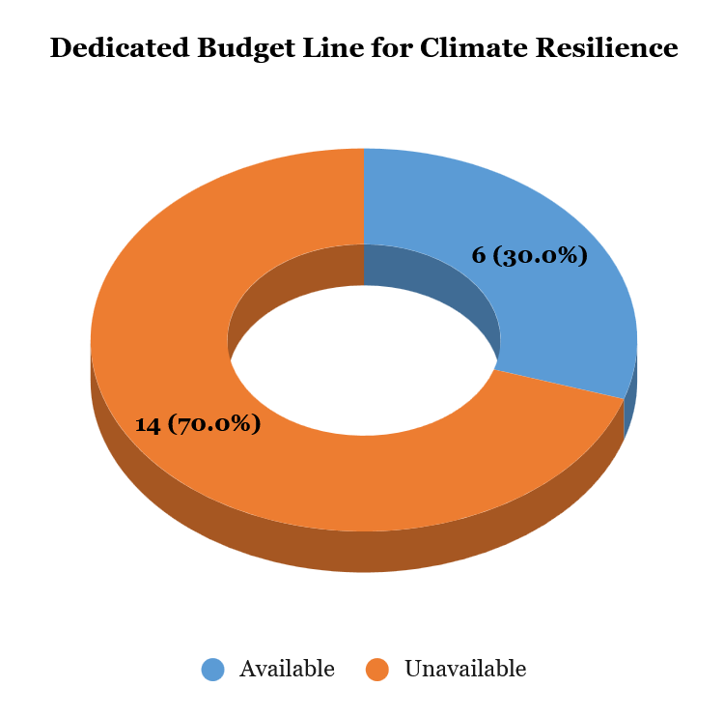
Dedicated Climate-Resilience Line in Annual Budget
Only 6 countries namely; Rwanda, Togo, Sierra Leone, Malawi, Mozambique and Tanzania, reported having a dedicated budget line for climate resilience in their policies or budgets.
Rwanda has a climate resilience budget line in the road maintenance budget and performance-based road contracts (OPRCs) and it is mandatory demonstrating a strong, institutional commitment.
Malawi and Benin have specific policies on climate resilience in road maintenance.
In Mozambique, although there is a budget line, the amount that can be allocated corresponds to only 5% of needs.

Slide 34
Key Conclusions
Significant Funding Gap: The report's most significant finding is the widespread funding gap for road maintenance. On average, only 37.7% of annual maintenance needs are funded. This has serious implications for network sustainability and contributes to a growing maintenance backlog. The funding shortfall is worsened by the predominance of unpaved road networks, which are highly vulnerable to weather events and require more frequent maintenance.
Gap in Digital Readiness: A critical observation is the low rate of Road Asset Management System (RAMS) implementation. Only 6 out of 20 countries (30%) have an operational RAMS. This highlights a major barrier to data-driven decision-making and efficient resource allocation.
Institutional Evolution vs. Innovation: The analysis shows that while most road funds are institutionally mature, their age does not directly correlate with the adoption of advanced models. For example, the report notes that the transition to a higher-generation road fund model is driven by a proactive commitment to sector reform, not simply institutional longevity.
Limited Climate Resilience Focus: Only a small number of countries have a dedicated budget line or policy for climate resilience, indicating that a robust approach to this critical issue is not yet a widespread practice.

Slide 35
Technical Assistance to Support the Africa Transport Policy Program (SSATP) Fourth Development Plan (DP4) Implementation
José Cordovilla
Team Leader
jcordovilla@typsa.es
Enrique José Piñero Piolestan
Climate Resilience Expert
epinero@typsa.es
Dr. Sid Boubekeur
Coordinator, Public Financing Expert
Sid.boubekeur3@gmail.com
Maurice Niaty-Mouamba
Governance Expert
mniatymouamba@gmail.com
Annstellah Wanjiru Maina
Data Analyst Expert
annstellahwanjiru@gmail.com
THANK YOU
EC-INTPA/2024/EARP/0021

